Slide 1
Unit Test

Slide 2
Agenda
What is Unit Testing?
Structure of an Unit Test Class
Introducing Attributes in Test Class
Demo
Code Coverage
References
QA?

Slide 3
What is Unit Test?
  Unit Testing is an important step in programming.
  Make sure not exist logic errors before release new code to QA or QC to test.
  Example:
  private bool CompareString(string str1, string str2)
  {
  return str1.Equals(str2);
  }
  If str1 = null, str2 = null then throw an exception, unit tests will remind developer in case str1 = null

Slide 4
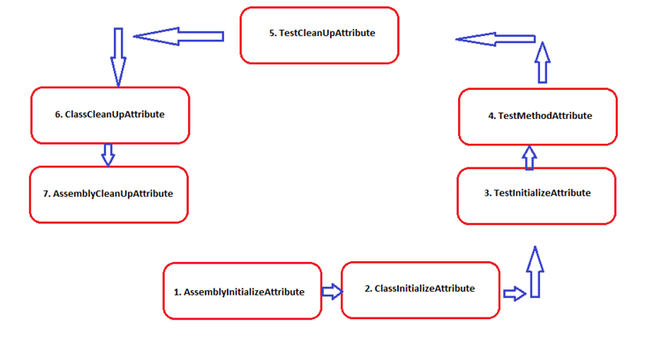
Structure of An Unit Test Class
Namespace: Microsoft.VisualStudio.TestTools.UnitTesting
The order that methods will be run is:

Slide 5
Introducing Attributes in Test Class
ClassInitializeAttribute
ClassCleanupAttribute
TestInitializeAttribute
TestCleanupAttribute
TestMethodAttribute
TestMethodAttribute
DeploymentItemAttribute
TestPropertyAttribute

Slide 6
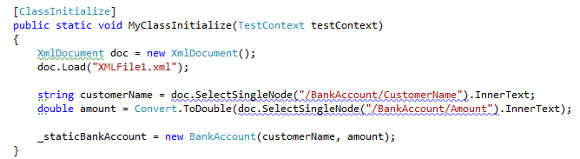
ClassInitializeAttribute
  Used to setup anything needed by all the test methods that will be run in the class. Examples of this would be to create test data, to copy test file, etc…
  Takes TestContext variable as parameter.
  One class initialize method per unit test class.
Notes:
Intialize điều kiện và môi trường trước khi thực thi cách test methods trong class

Slide 7
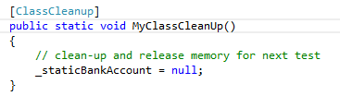
ClassCleanupAttribute
  Usually used to delete all data that created by the class initialize.
  One class cleanup per unit test class.
Notes:
Clean up sao khi đã finish unit tests của class.

Slide 8
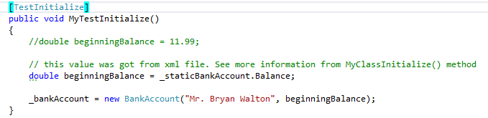
TestInitializeAttribute
  Run before the execution of every test method in the class
  Used to manage resources shared by the test methods in the class.
  Used to setup test environment
  One test initialize method per unit test class.

Slide 9
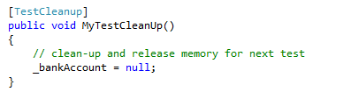
TestCleanupAttribute
  Run after the execution of every test method in the class
  Used to return test environment to a known state or clean up all data created by a test.
  One test cleanup per unit test class

Slide 10
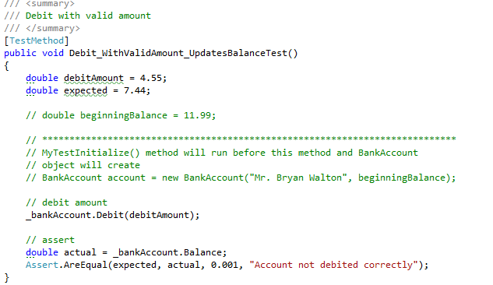
TestMethodAttribute
1-n test methods per unit test class
A test method should test a single requirement only.
Notes:
Để việc viết unit test dể dàng thì mổi Method chỉ nên đảm nhiệm 1 công việc duy nhất, chúng ta nen refactor code nếu thấy method đó quá phức tạp và khó khăn khi viet unit test

Slide 11
TestMethodAttribute
Notes
Test method names should clearly indicate the purpose of the test.
For tests that test a public property, class method, use name with the word test appended.
Ex : CompareStringTest
Use ExpectedException attribute of the test method to ensure that a specific exception is thrown if the application should throw it for excepted errors.
Use assert class to check for various expected conditions or state such as Boolean value, equality…

Slide 12
DeploymentItemAttribute
Used to specify deployment items such as files or directories for per-test deployment. This class cannot be inherited.
The following examples demonstrate different usage of the DeploymentItemAttribute:
  [DeploymentItem("file1.xml")]
  [DeploymentItem("file2.xml", "DataFiles")]
  [DeploymentItem("C:\\MyDataFiles\\")]
  [DeploymentItem("%myDir%\myFile.txt")]
Notes:
[DeploymentItem("file1.xml")] Deploys an item named file1.xml located at the RelativeRootPath. The file is deployed to the deployment root directory.
[DeploymentItem("file2.xml", "DataFiles")] Deploys an item named file2.xml located at the RelativeRootPath. The file is deployed to the DataFiles subdirectory of the deployment root directory.
[DeploymentItem("C:\\MyDataFiles\\")] Deploys all items and directories found within the MyDataFiles directory. This does not create the MyDataFiles directory underneath the deployment directory. All files and directories within MyDataFiles will be deployed to the deployment root directory. To copy the entire MyDataFiles directory structure, you must specify MyDataFiles as an output directory.
[DeploymentItem("%myDir%\myFile.txt")] Deploys the file myFile.txt if that file exists in the directory to which %myDir% resolves.

Slide 13
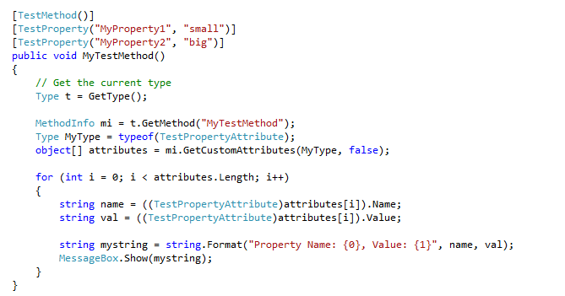
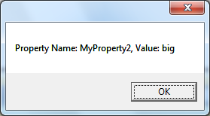
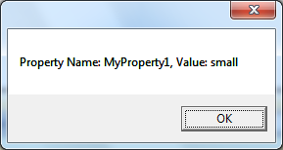
TestPropertyAttribute
Establishes a test specific property on a method. This class cannot be inherited.
Test methods can have multiple test property attributes specified.
Used to pass general name/value pair data to a test.

Slide 14
Test Method Comments
Best practice to have a good comment header for each test method to clearly indicate what is being tested.
Should including the following:
  Purpose: short description of aspect of application being tested.
  Test data : data being used
  Step : list of steps in test
  Remarks : any pertinent information about test not covered elsewhere but important to note

Slide 15
DEMO

Slide 16
Code Coverage in Visual Studio

Slide 17
What is Code Coverage?
Code Coverage is a measurement of how many lines /blocks (i.e. % of code tested) of your code are executed while the unit tests are running
Visual Studio has integrated tools to collect code coverage
Notes:
code-coverage to highlight bits of code that I should probably write tests for. For example, if whatever code-coverage tool shows myImportantFunction() isn't executed while running my current unit-tests, they should probably be improved.

Slide 18

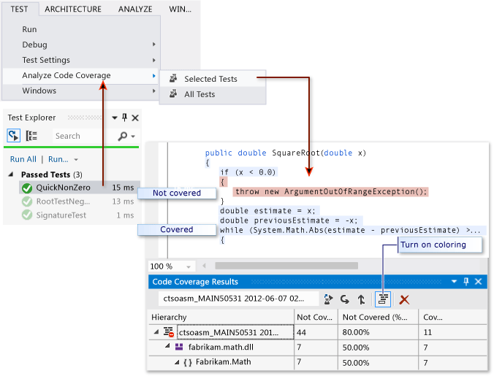
Run Code Coverage in Visual Studio
Notes:
Code coverage analysis can be applied to both managed (CLI) and unmanaged (native) code.
Code coverage is an option when you run test methods using Test Explorer. The results table shows the percentage of the code that was run in each assembly, class, and method. In addition, the source editor shows you which code has been tested.

Slide 19
To analyze code coverage on unit tests in Test Explorer
On the Test menu, choose Analyze Code Coverage.
To see which lines have been run, choose Show Code Coverage Coloring.
To alter the colors, or to use bold face, choose Tools->Options->Environment->Fonts and Colors->Show settings for: Text Editor. Under Display Items, adjust the Coverage items.
If the results show low coverage, investigate which parts of the code are not being exercised, and write more tests to cover them. Development teams typically aim for about 80% code coverage.
Notes:
Q & A: In some situations, lower coverage is acceptable. For example, lower coverage is acceptable where some code is generated from a standard template.

Slide 20
References
Unit Testing Framework
  http://msdn.microsoft.com/en-us/library/ms243147(v=vs.80).aspx
Test Coverage
  http://msdn.microsoft.com/en-us/magazine/cc163981.aspx
  http://msdn.microsoft.com/en-us/library/dd537628.aspx

Slide 21
Question & Answer
Notes:
http://msdn.microsoft.com/en-us/data/dd363565.aspx

